Slide 1


Stock PRICE FORECAST using tspdb and docker

Slide 2

INTRODUCTION
Stock market is considered the primary indicator of a country’s economic strength and development. Stock Market prices are volatile in nature and are affected by factors like inflation, economic growth, etc. Prices of a share market depend heavily on demand and supply.
Stock market is often seen as a dynamic structure with significant changes over time , this nature leads challenges in predicting the individual stock price within the market.
Machine Learning algorithms have proved to fetch benevolent results in predicting stock prices.

Slide 3
Continuous integration which is an important method practiced during the application lifecycle is also performed.
We utilized tspDB (which is a tool created by MIT researchers and outperforms machine learning algorithms like prophet, TRMF, LSTM etc.) to build a stock prediction app
We also performed continuous integration using git, docker, jenkins.
Tools: python, tspDB, PostgreSQL, streamlit, ngrok, docker, git, jenkins

Slide 4
LITERATURE SURVEY
http://proceedings.mlr.press/v133/agarwal21a/agarwal21a.pdf
In multivariate time series data, that is, data where each unit (e.g. collection of stocks, temperature readings from a collection of sensors) is associated with a time stamp. We do so as this is one of the primary ways data is structured in a range of important applications including finance, healthcare, retail, to name a few.
We consider two types of prediction tasks for time series data: (i) imputing a missing or noisy observation for a time series datapoint we do observe; (ii) forecasting a time series data point in the future (i.e., data that is as of yet unobserved).
The algorithm used is singular spectrum analysis (SSA), that imputes and forecasts single time series

Slide 5
https://www.researchgate.net/publication/260124592_Singular_Spectrum_Analysis_for_Time_Series
SSA algorithm involves 4 steps:
Embedding: mapping that transfers a one-dimensional time series into the multidimensional series
Singular Value Decomposition (SVD)
Grouping: procedure of arranging the matrix terms
Diagonal Averaging: transform each matrix of the grouped decomposition into a new series
https://www.researchgate.net/publication/318816158_An_Introduction_to_Docker_and_Analysis_of_its_Performance
https://towardsdatascience.com/streamlit-deploy-a-machine-learning-model-without-learning-any-web-framework-e8fb86079c61
https://towardsdatascience.com/mlops-with-docker-and-jenkins-automating-machine-learning-pipelines-a3a4026c4487

Slide 6
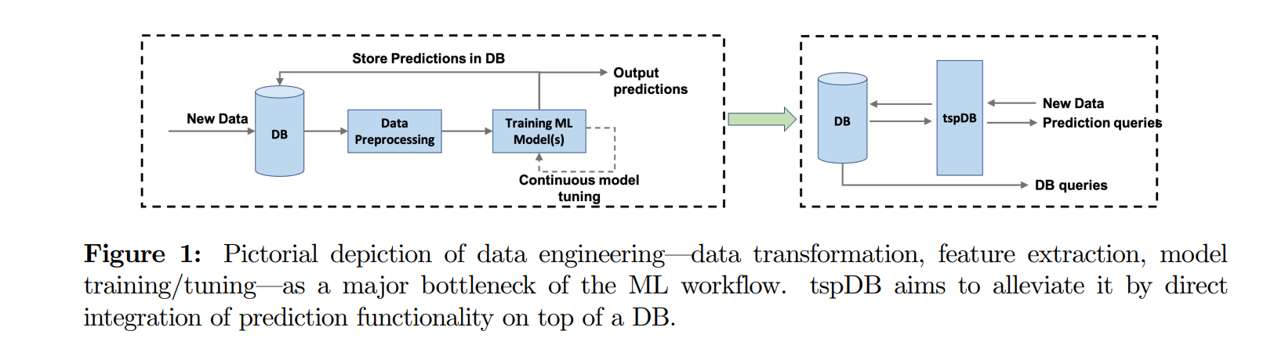
TOOLS USED
a) tspDB
MIT Researchers designed tspDB, that is an extension to PostgreSQL, enables state-of-the-art predictive query functionalities in any existing time-series relational DB.
It integrates prediction functionality on top of an existing time-series database.

Slide 7
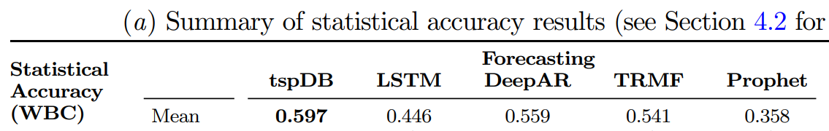
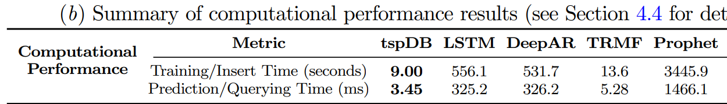
it is necessary that we evaluate ML algorithms/systems not just through prediction accuracy, but through computational metrics as well. We consider two important computational metrics:
(i) the time it takes to train a ML model (ii) the time it takes to answer a prediction query
We find tspDB outperforms the various popular existing time series libraries we compare against with respect to all three metrics we consider— statistical performance, speed of training the ML model and latency in making a prediction.
WBC takes value in [0,1]: 0.5 - equal performance on average compared to all other algorithms, 1-“infinitely” superior performance

Slide 8
The new system is more accurate and more efficient than state-of-the-art deep learning methods by performing two tasks:
imputing a missing or noisy observation for a time series datapoint we do observe.
forecasting a time series data point in the future (i.e., data that is as of yet unobserved).
The algorithm used is singular spectrum analysis (SSA), that imputes and forecasts single time series
SSA algorithm involves 4 steps:
Embedding: mapping that transfers a one-dimensional time series into the multidimensional series
Singular Value Decomposition (SVD)
Grouping: procedure of arranging the matrix terms
Diagonal Averaging: transform each matrix of the grouped decomposition into a new series
For multivariate time series, instead of transforming the series into a big matrix, it is viewed as a tensor
the system could enable to predict future stock prices with high accuracy in just a few minutes, even if the time-series dataset contains missing values.

Slide 9
b) Docker
Docker is an open platform for developing, shipping, and running applications.
Docker enables you to separate your applications from your infrastructure so you can deliver software quickly.
With Docker, you can manage your infrastructure in the same ways you manage your applications.
By taking advantage of Docker’s methodologies for shipping, testing, and deploying code quickly, you can significantly reduce the delay between writing code and running it in production.
Docker uses a client-server architecture. The Docker client talks to the Docker daemon, which does the heavy lifting of building, running, and distributing your Docker containers.

Slide 10
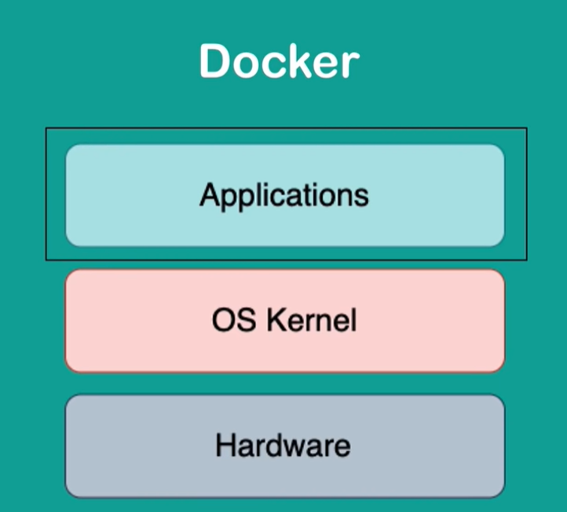
The Docker client and daemon can run on the same system, or you can connect a Docker client to a remote Docker daemon. The Docker client and daemon communicate using a REST API, over UNIX sockets or a network interface.
Another Docker client is Docker Compose, that lets you work with applications consisting of a set of containers.

Slide 11
c) Postgres
PostgreSQL has a rich history for support of advanced data types, and supports a level of performance optimisation that is usually associated with commercial database counterparts, like Oracle and SQL Server.
PostgreSQL is used as the primary data store or data warehouse for many web, mobile, geospatial, and analytics applications.
PostgreSQL can store structured and unstructured data in a single product. Unstructured data, found in audio, video, emails and social media postings, can be used to improve customer service, discover new product requirements, and find ways to prevent a customer from churning among countless other uses.
In our project we use postgres to store our data and let tspDB extension generate the machine learning model and have a prediction functionality on top of the database

Slide 12
d) Streamlit
Streamlit is an open source app framework in Python language. It helps us create web apps for data science and machine learning in a short time. It is compatible with major Python libraries such as scikit-learn, Keras, PyTorch, SymPy(latex), NumPy, pandas, Matplotlib etc.
Data caching simplifies and speeds up computation pipelines. Streamlit watches for changes on updates of the linked Git repository and the application will be deployed automatically in the shared link.
e) Jenkins
Jenkins is the most famous Continuous Integration tool.
Jenkins is an open-source automation tool written in Java with plugins built for Continuous Integration purposes.
Jenkins is used to build and test your software projects continuously making it easier for developers to integrate changes to the project, and making it easier for users to obtain a fresh build.

Slide 13
It also allows you to continuously deliver your software by integrating with a large number of testing and deployment technologies.
With Jenkins, organizations can accelerate the software development process through automation.
Jenkins integrates development life-cycle processes of all kinds, including build, document, test, package, stage, deploy, static analysis, and much more.

Slide 14
f) Git
Git is open-source version control software, used for managing and tracking file revisions.
It can be used with any file type, but is most often used for tracking code files. Git is the most widely used version control system in software development, and GitHub leverages this technology for its service, hence its name.
Advanced version control is necessary for software projects, especially collaborative ones. When building software, developers are frequently and simultaneously updating the code to add features and fix bugs.
It wouldn’t make sense to make these changes to the source code directly, since any issues would affect users. Instead, developers work with their own copies of the code, then — after the code has been thoroughly tested — add this code to the main codebase.

Slide 15
IMPLEMENTATION
MODULE 1
In this module, we build a postgres docker image
Instead of downloading the os specific software, installing it, configuring etc, we can build our own postgres image (based on an available postgres image in docker hub) which makes it easy during development and deployment phases.
We first create a Dockerfile that contains commands to be performed on the base postgres image.
The commands include FROM, RUN, ENV, COPY, EXPOSE etc.

Slide 16
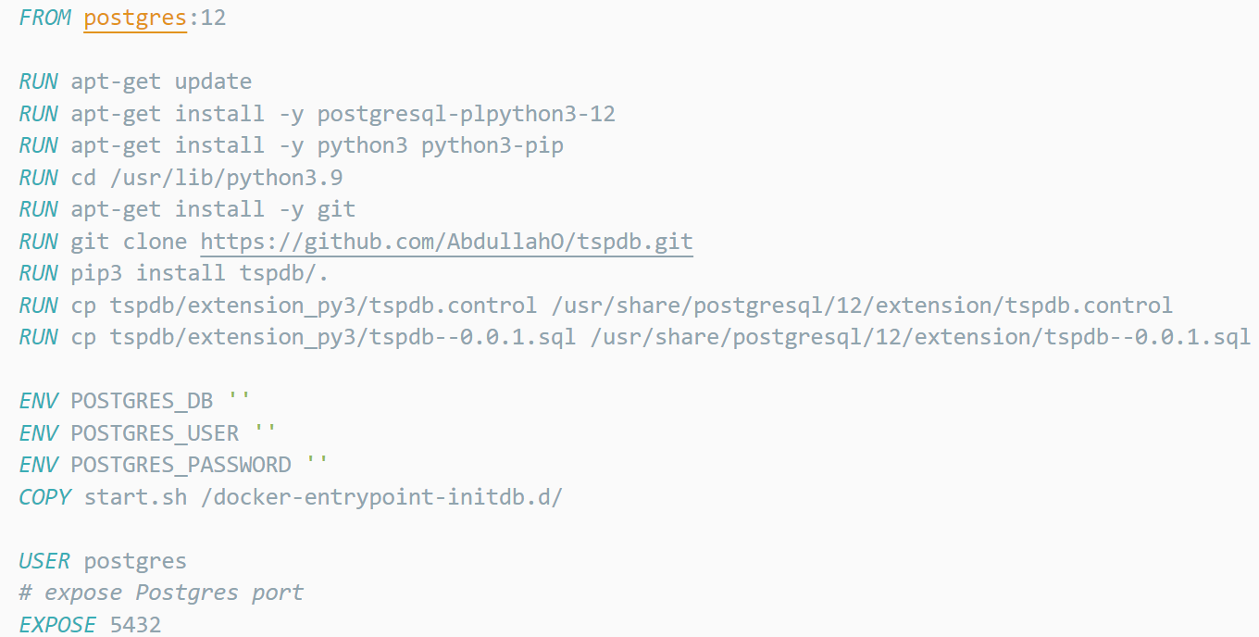
FROM command specifies the base image
RUN command executes the shell commands at build time and get written into Docker image as a new layer.
ENV for environment variables
EXPOSE is to make the port open
COPY for copying files on host machine into docker image.
We base our image on postgres 12
Apt-get update downloads the package lists from the repositories and "updates" them to get information on the newest versions of packages
Install plpython, python3, git using apt-get
Clone the source code for tspdb from git and install it in the python file directory using pip.
Copy the .control and .sql to the extension folder.
The .control file that tells Postgres some basics about your extension and the .sql file contains SQL script

Slide 17
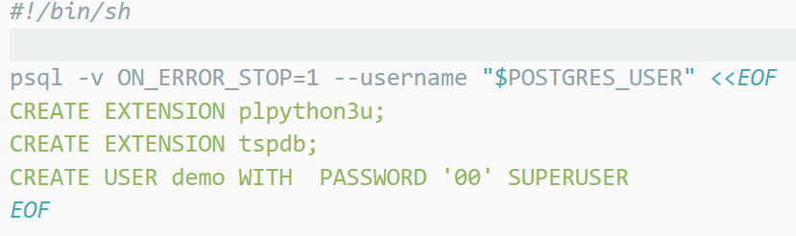
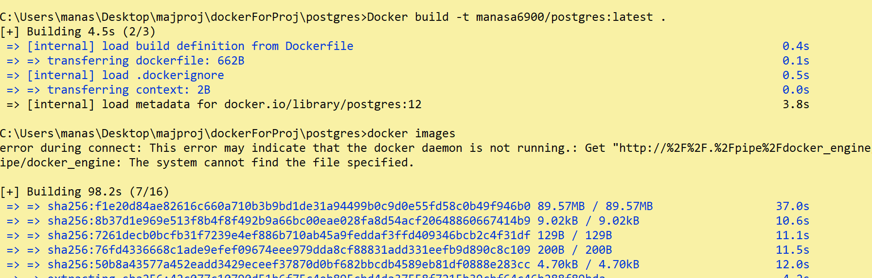
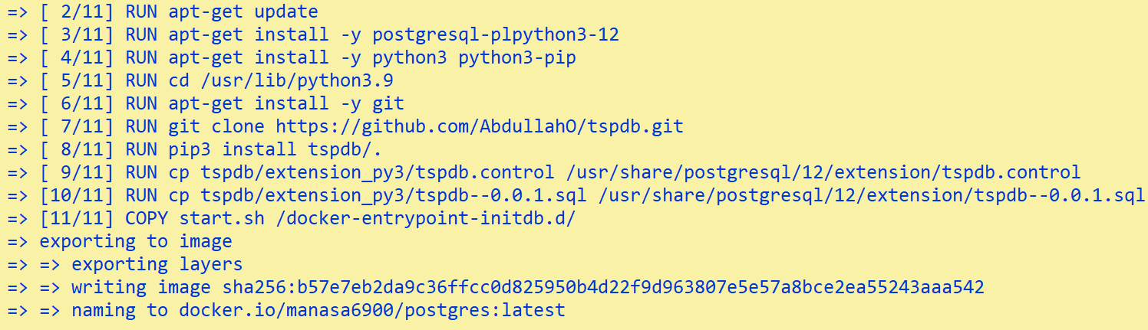
Copy the script.sh file into the docker-entrypoint-initdb.d directory.
It contains the script to be run right after the container starts.
Script file
Expose the port 5432 on the container so that our host can bind with the container and our app can connect to postgres.
Now we build the image using “ Docker build –t manasa6900/postgres:latest . ” –t means tag and ‘ . ’ Means that the Dockerfile is in the current directory.

Slide 18
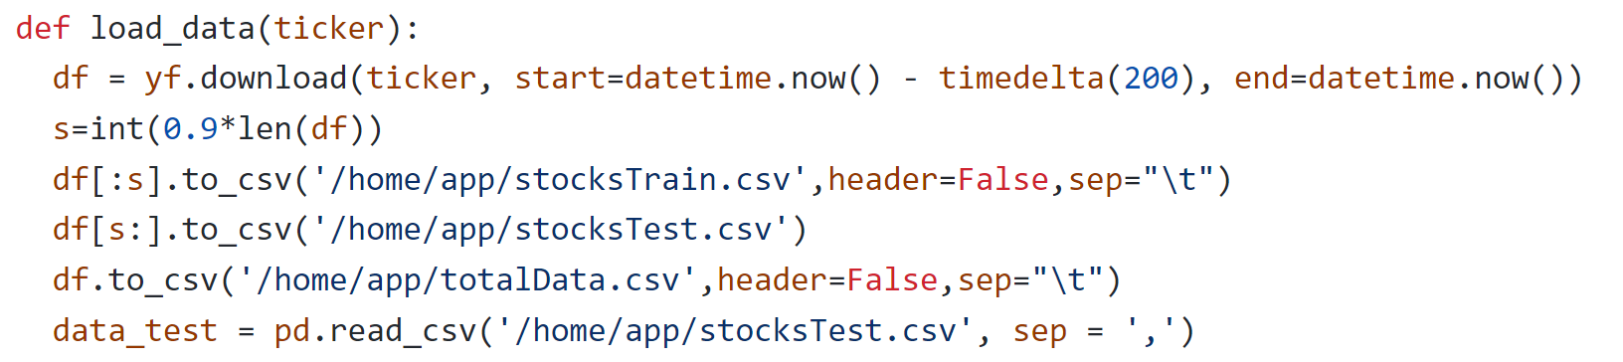
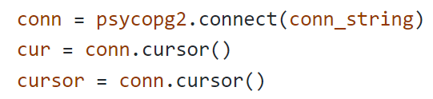
MODULE 2
In this module, the stock price prediction application is built.
get the historical data from yahoo finance(using yfinance module) for the user specified stock. We take the previous 200 days data. Store the data in totalData.csv
Split the data into training and test set. Store training data in stocksTrain.csv and test data in stocksTest.csv
Connect the app to postgres server (use the docker container db ) using psycopg2

Slide 19
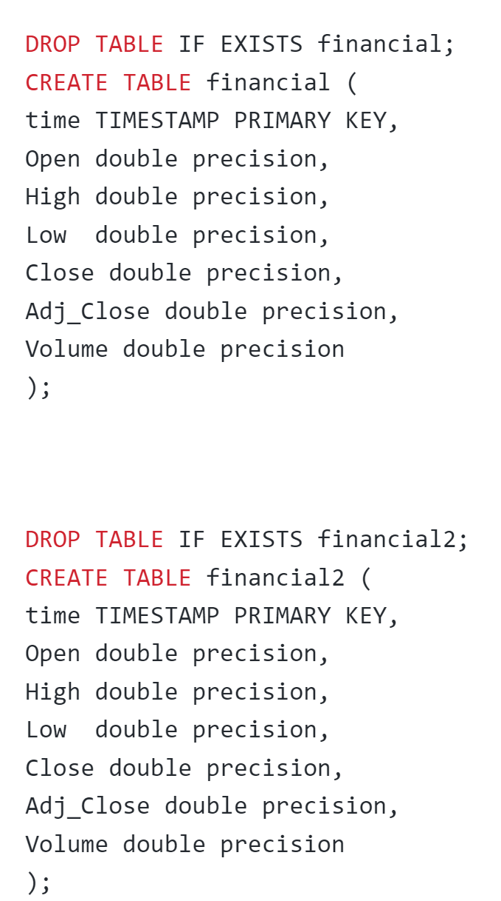
Create a table called financial using load_data_Stock.sql file that contains the sql code to create a table. The table consists of training data.
Create a prediction index, which we will call pindex1 on the columns ("close", "high", "low"). The creation of this prediction index allows for retrieving predicted values for entries that are:
1. At a future time step (i.e. forecasting) 2. Missing/corrupted by noise (i.e. imputation)
cursor.execute("""select create_pindex('financial', 'time','{ "close","high","low"}','pindex1');""")
use tspDB's function predict_range() to predict the time series ”close” for the next 60 days
pd.read_sql_query("select * from predict('financial','close','%s','%s','pindex1');"%(data_test.iloc[0]['Date'],data_test.iloc[-1]['Date']), conn)
Compare the predicted data to the test data using root mean square error as the error metric.
load_data_Stock.sql FILE

Slide 20
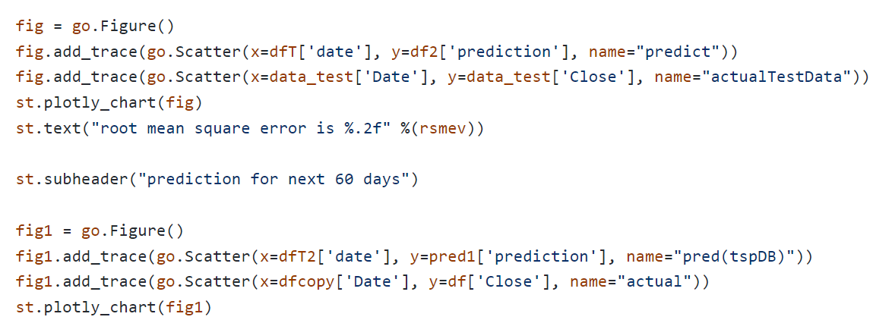
Draw graphs using plotly :-
1. test data vs predicted data
2. prediction for next 60 days of the stock price
Use the streamlit framework to display title, headings, subheadings , graphs, rmse etc.

Slide 21
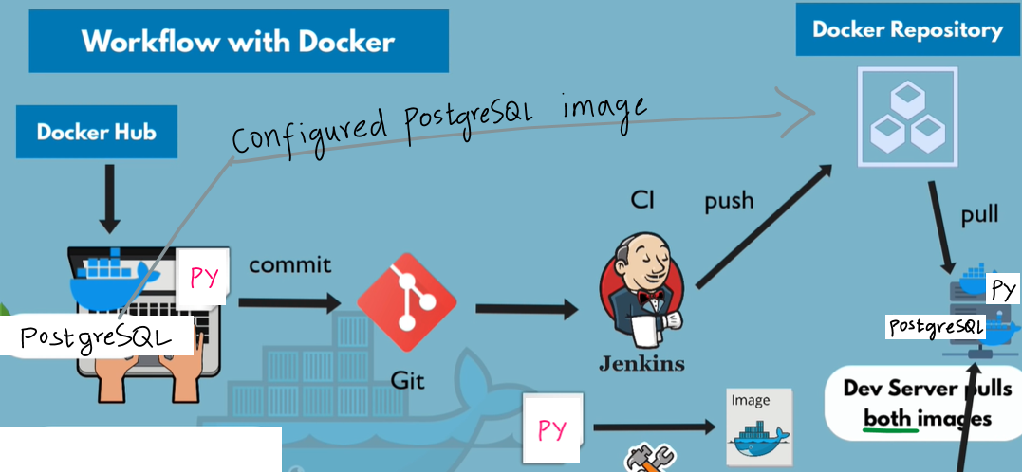
MODULE 3
In this module, the stock price prediction application will be containerized into a docker image by Jenkins. Continuous integration is carried out.

Slide 22
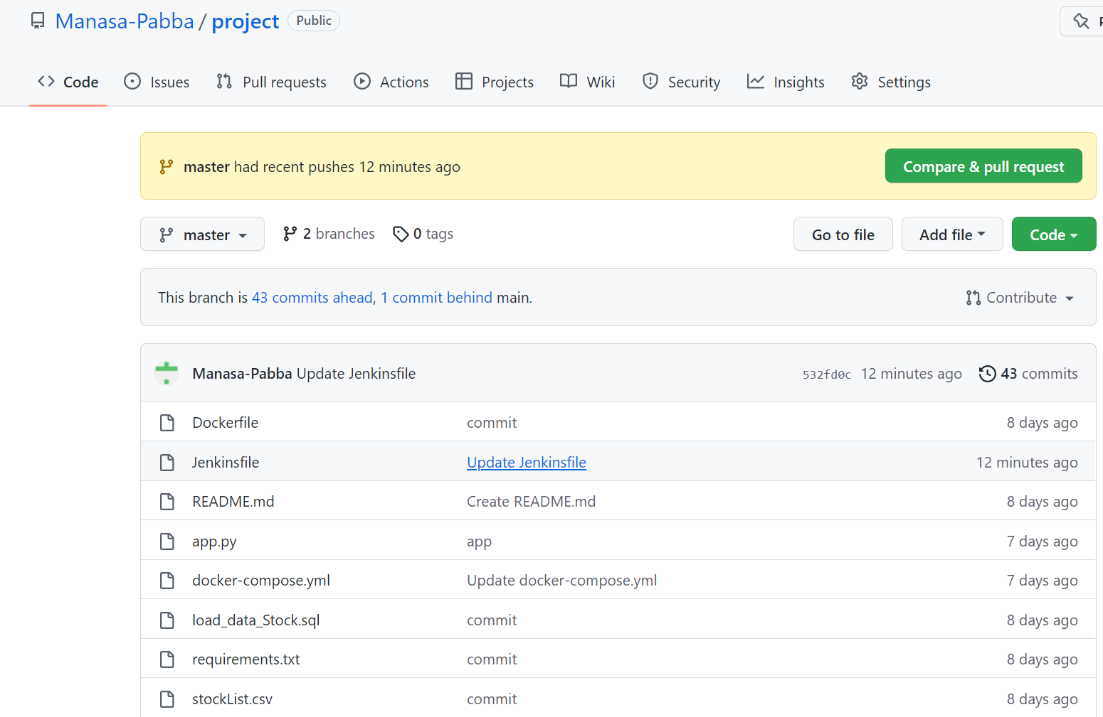
Create a github account and commit the application to the master branch
Files in github

Slide 23
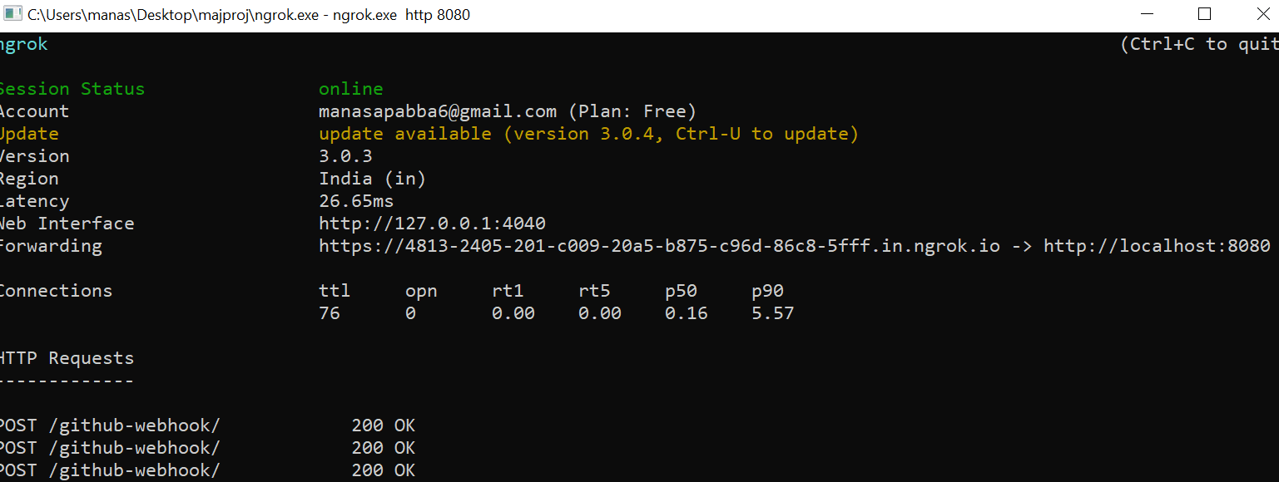
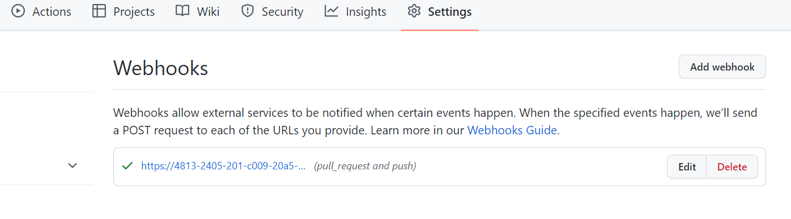
Now, for jenkins to get triggered each time a commit occurs, we add a GitHub webhook. For this, we need a public ip address of Jenkins server. So, we use ngrok that exposes the local server port of jenkins to the Internet.
Conifigure jenkins to automatically run the jenkinsfile when it gets notified by the github webhook.
ngrok

Slide 24
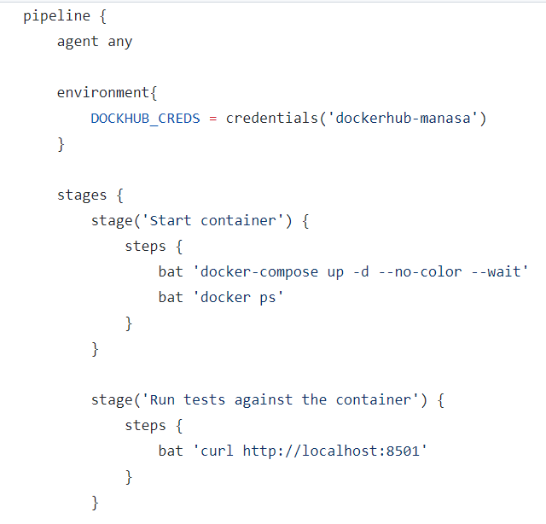
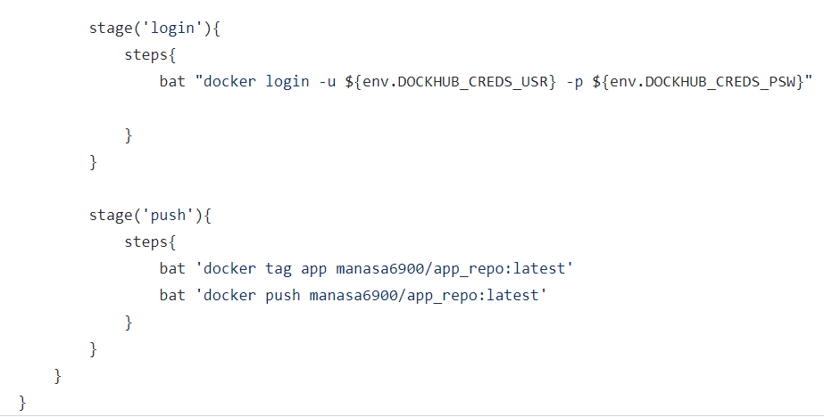
Build a Jenkins pipeline that runs a Jenkinsfile each time a GitHub commit occurs by adding a webhook. The jenkinsfile is commited to the github repo along with the application code.

Slide 25
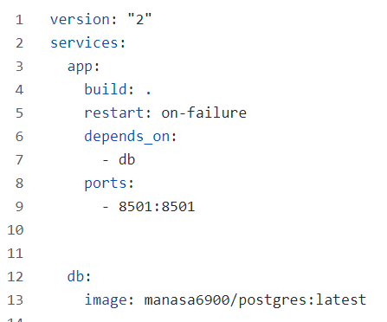
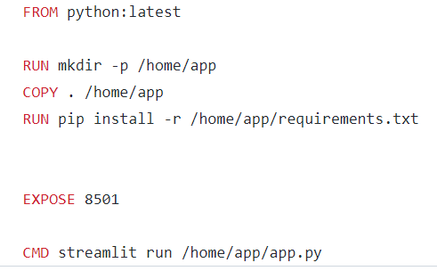
The Jenkinsfile contains 4 stages.
1) Build the application image and then start both the containers i.e. db, app using docker-compose file. The Dockerfile to build the app is also committed to GitHub.
Dockerfile for app docker-compose file

Slide 26
We based our image on python image. Make a directory in the container and copy the application files into that directory.
Install necessary packages that are specified in the requirements.txt
Expose port 8501 of the container. The CMD command is used to execute a command right after the container starts
the docker compose file starts 2 services. i.e postgres db image that we developed in module 1 and the app image that we build from our dockerfile.
Docker compose automatically created a network for these 2 containers. So these containers can communicate using container names instead of ip addresses.

Slide 27
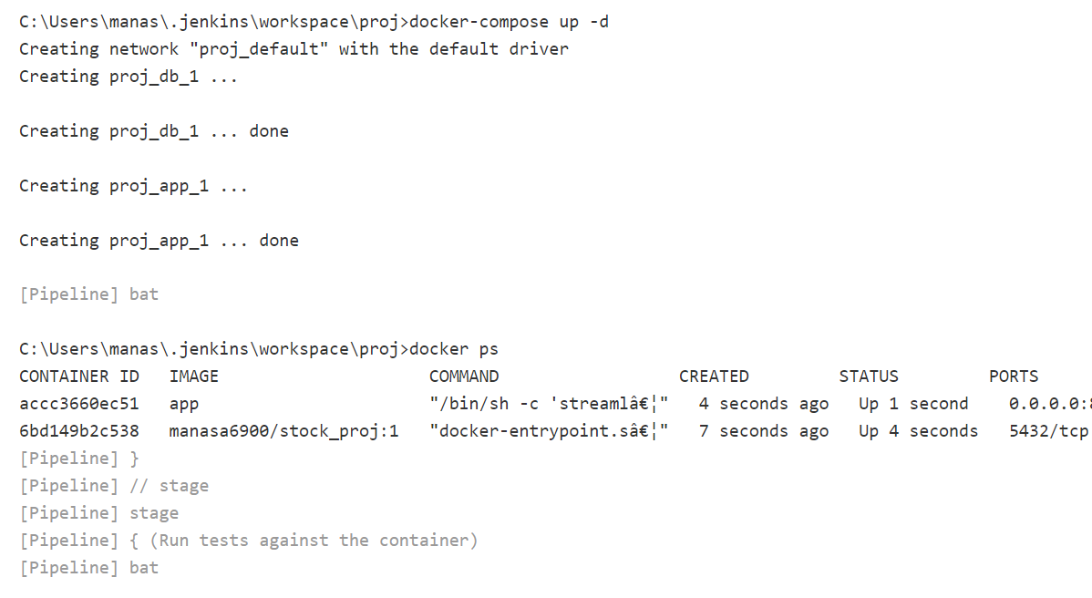
console log of step 1

Slide 28
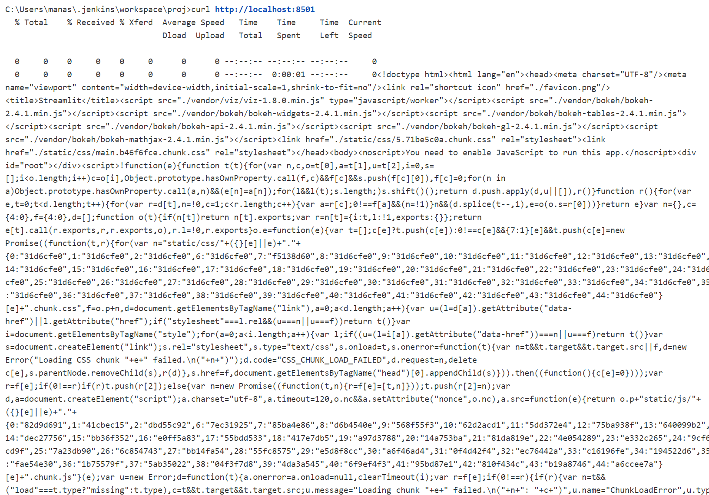
2) run a curl command to check if the web application is up and running.
console log of step 2

Slide 29
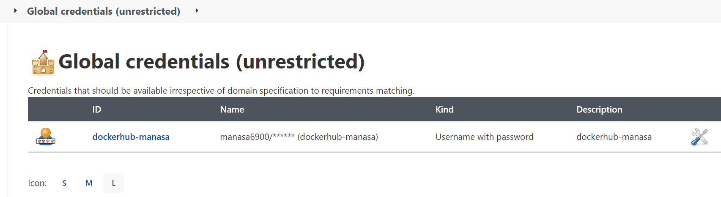
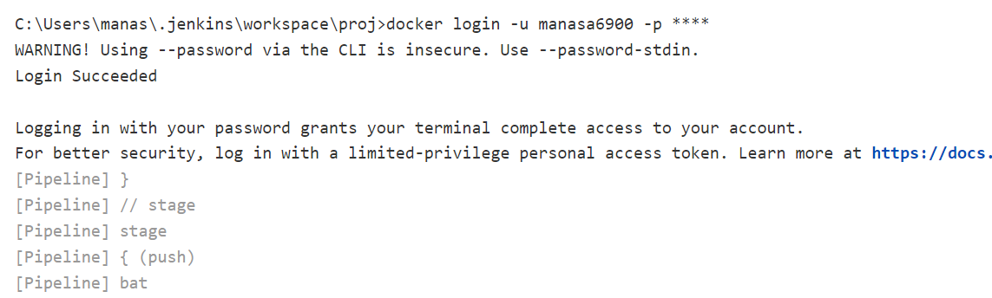
3) Log into docker hub using dockerhub credentials that are added in Jenkins.
console log of step 3
credentials stored in jenkins

Slide 30
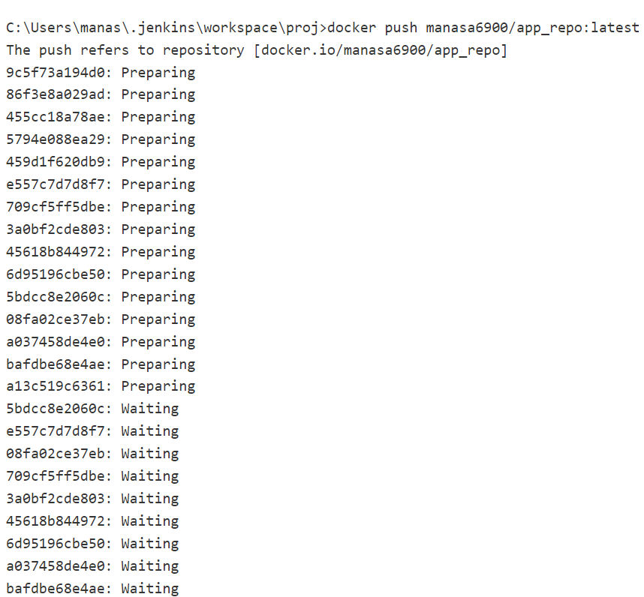
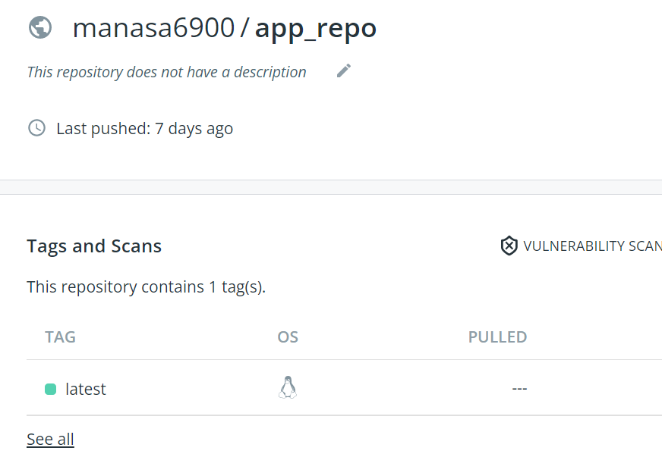
4) Tag and push the containerized application to dockerhub
console log of step 4
The application is pushed into app_repo

Slide 31
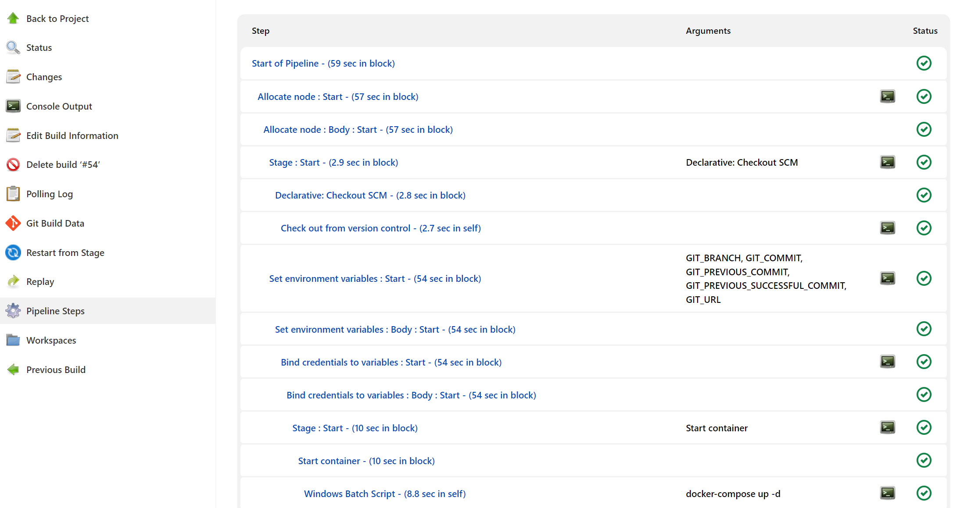
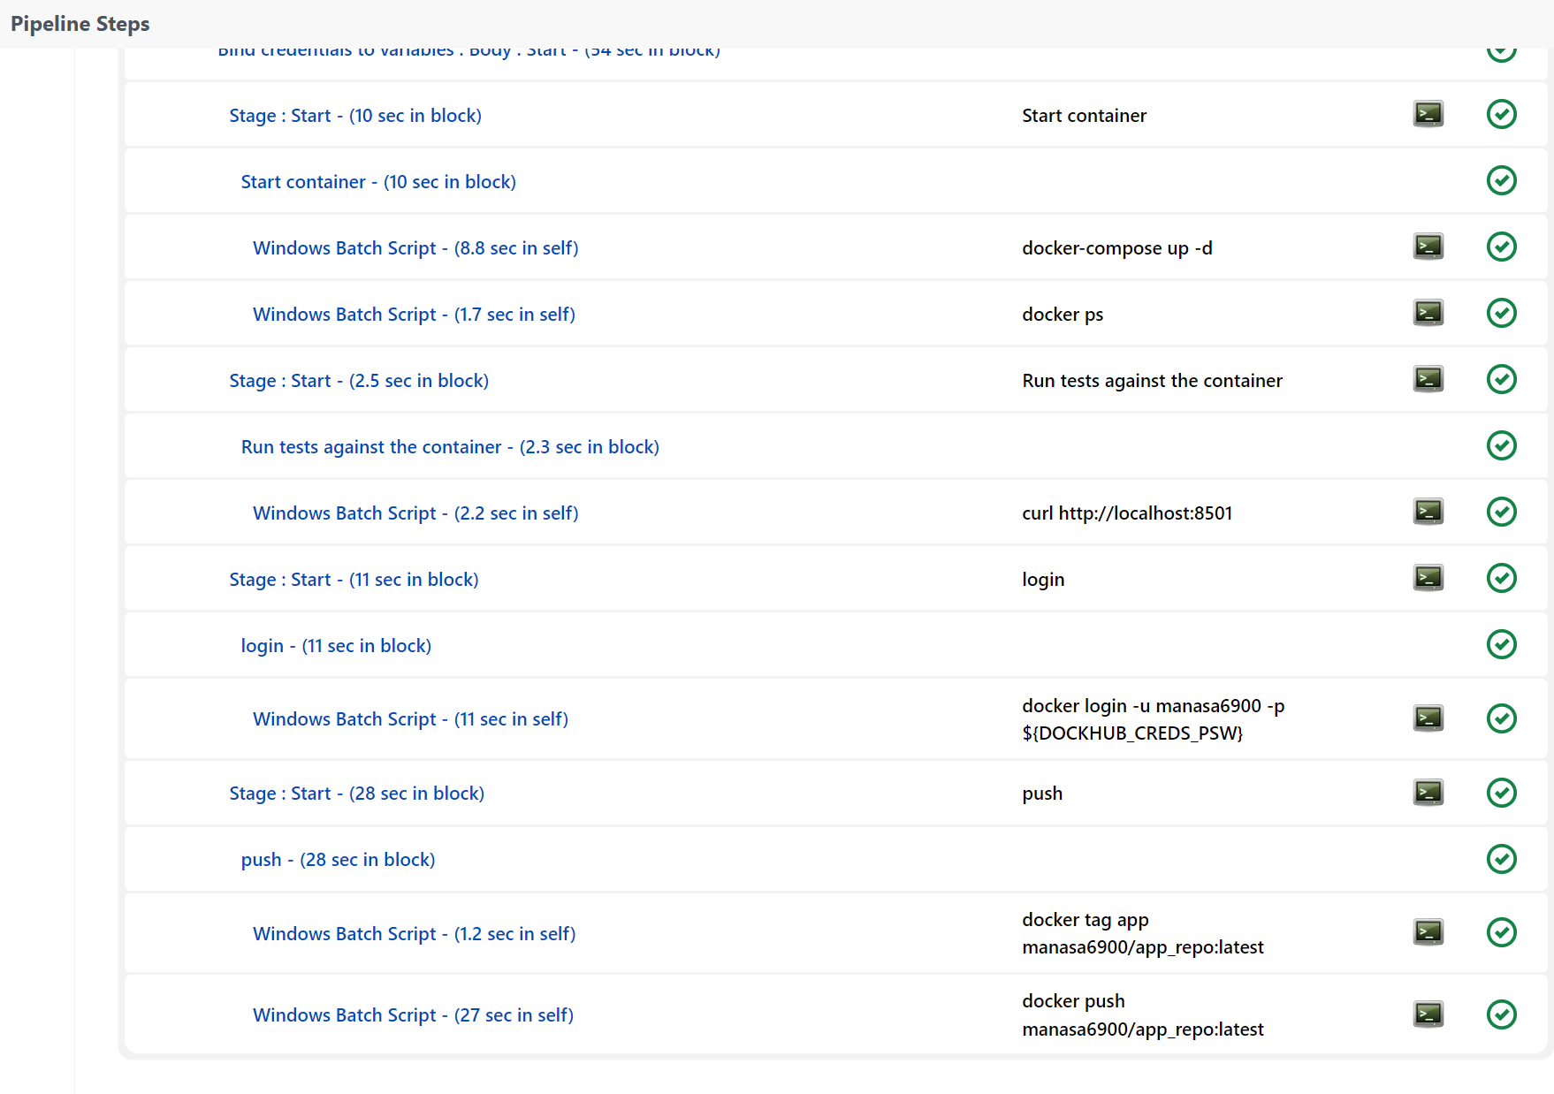
steps executed in jenkins

Slide 32
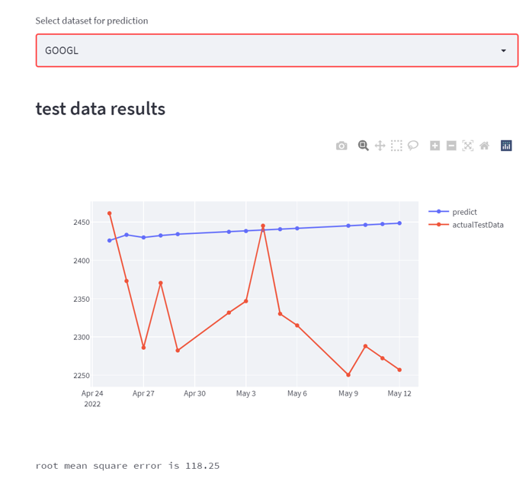
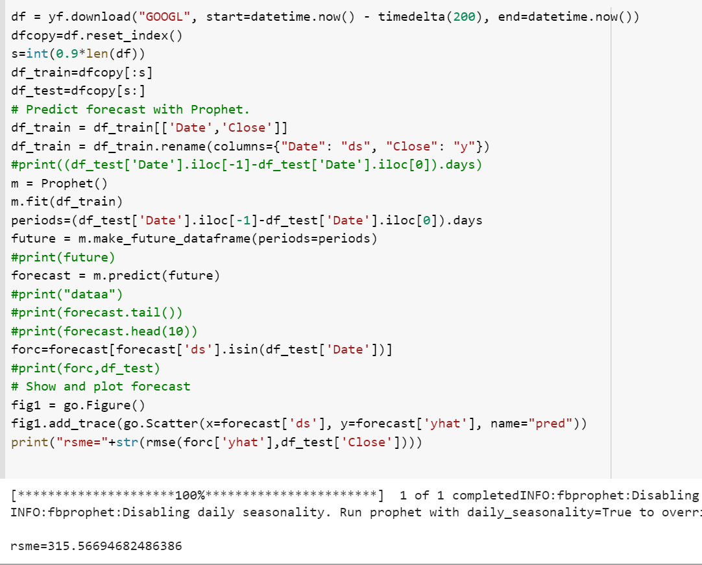
Comparison of prophet with tspdb
prophet
tspdb
Error: 315
Error: 315
Error: 118
Google stock

Slide 33
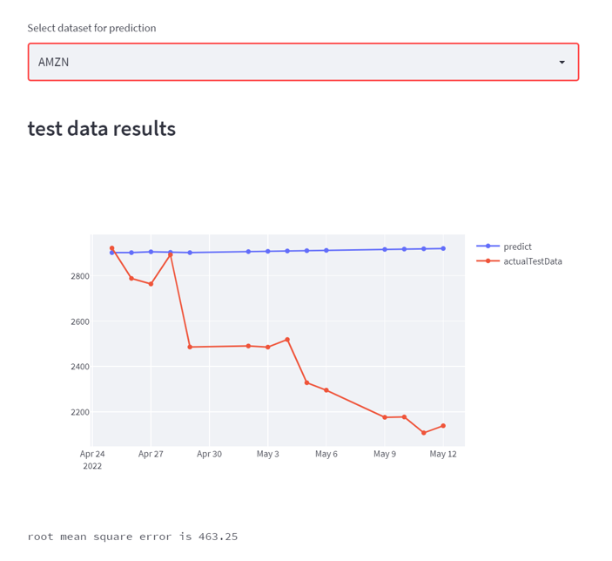
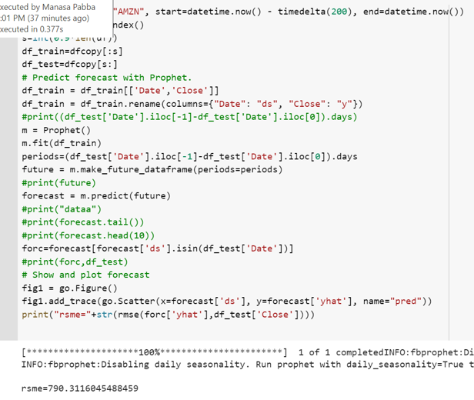
prophet
tspdb
Error: 790
Error: 463
Amazon stock

Slide 34
RESULTS
By typing http://localhost:8501 in our web browser, we can see the stock forecast app running.
We predict for microsoft stock

Slide 35
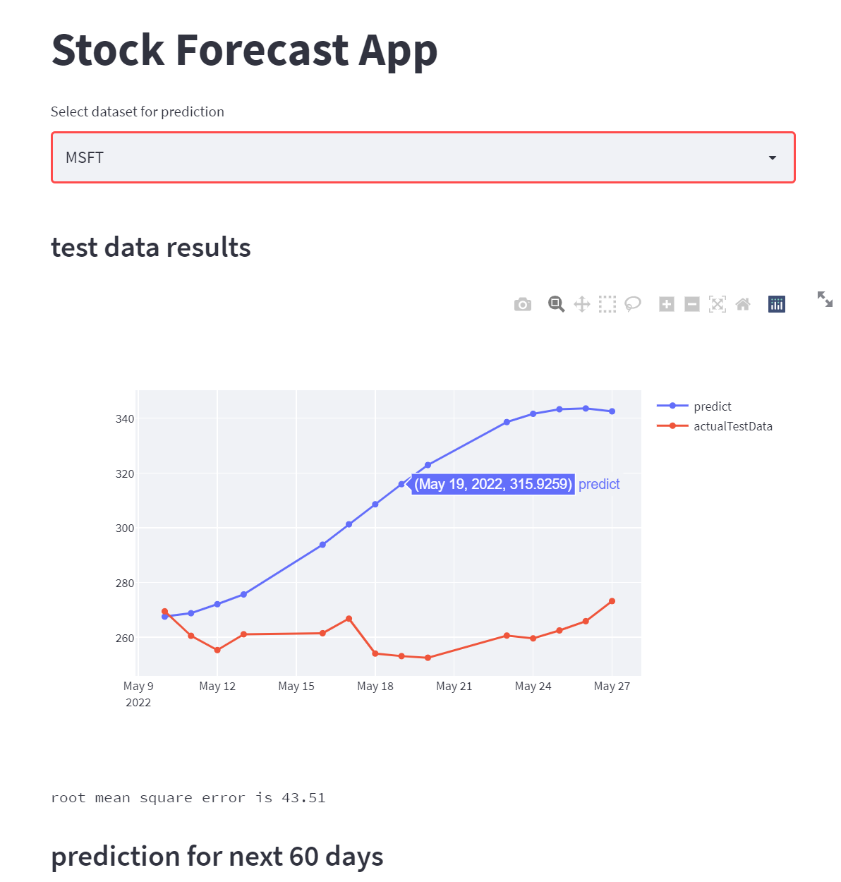
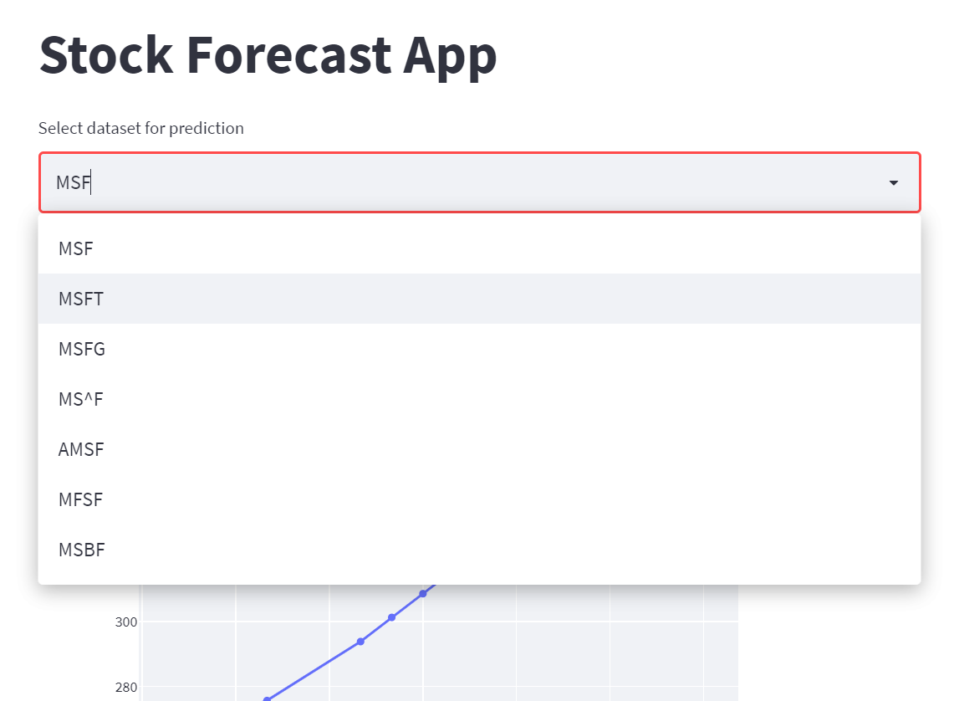

Slide 36
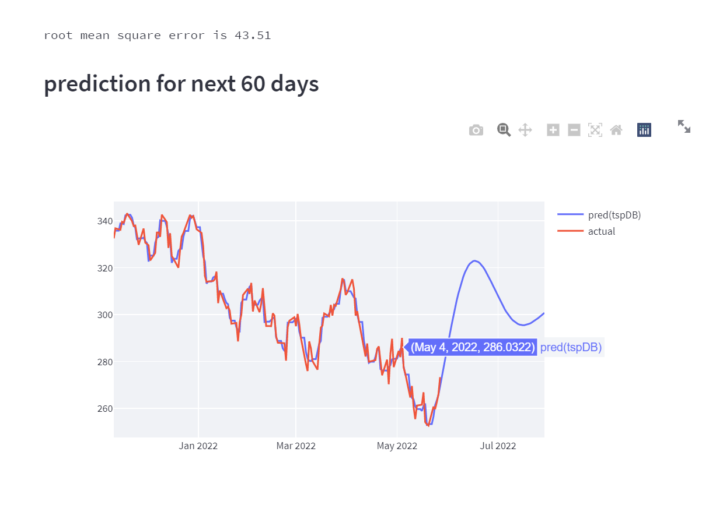

Slide 37
DEMO

Slide 38
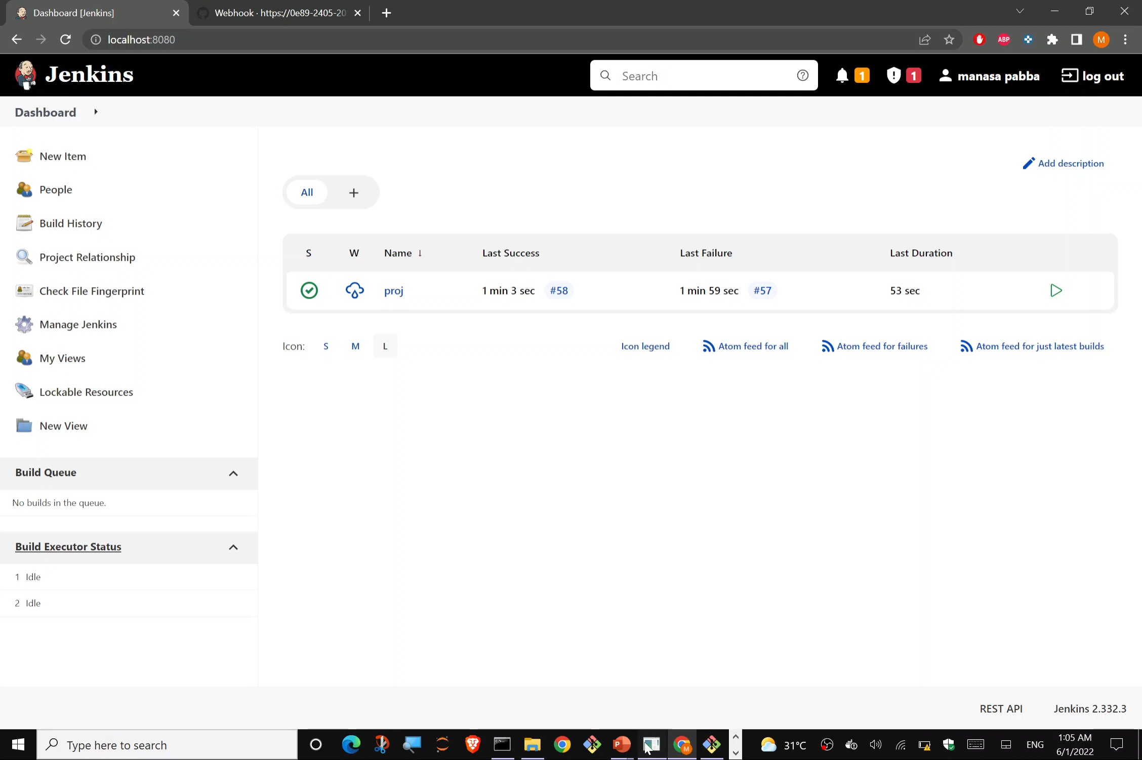

Slide 39
